Slide 1
Server-side Programming
Web browsers communicate with web servers using the HyperText Transfer Protocol (HTTP). When you click a link on a web page, submit a form, or run a search, an HTTP request is sent from your browser to the target server.
The request includes a URL identifying the affected resource, a method that defines the required action (for example to get, delete, or post the resource), and may include additional information encoded in URL parameters (the field-value pairs sent via a query string), as POST data (data sent by the HTTP POST method), or in associated cookies.
Web servers wait for client request messages, process them when they arrive, and reply to the web browser with an HTTP response message. The response contains a status line indicating whether or not the request succeeded (e.g. "HTTP/1.1 200 OK" for success).
The body of a successful response to a request would contain the requested resource (e.g. a new HTML page, or an image, etc...), which could then be displayed by the web browser.

Slide 2
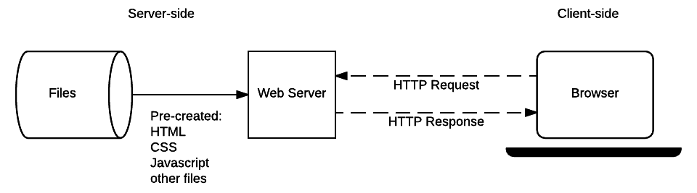
Server-side Programming: Static Sites

Slide 3
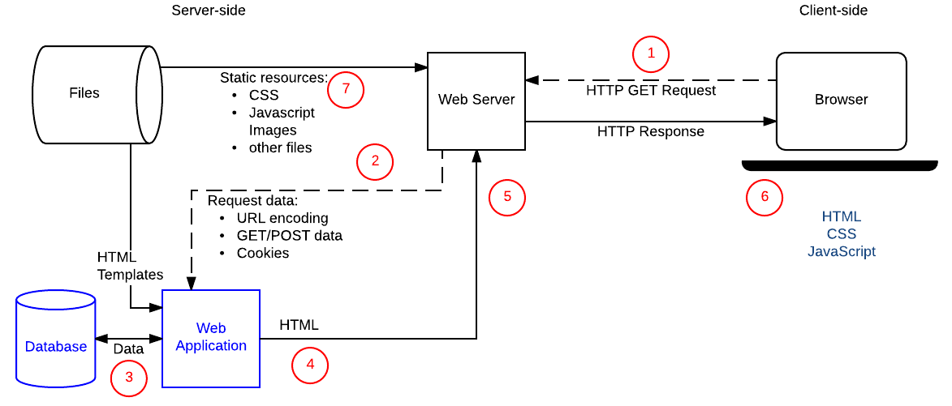
Server-side Programming: Dynamic Sites

Slide 4
Server-side Programming: Web Frameworks
Web frameworks provide tools and libraries to simplify common web development operations. You don't have to use a server-side web framework, but it is strongly advised — it will make your life a lot easier.
What can a framework do for you?
Work directly with HTTP requests and responses
Route requests to the appropriate handler
Make it easy to access data in the request
Abstract and simplify database access
Rendering data

